Slide 1





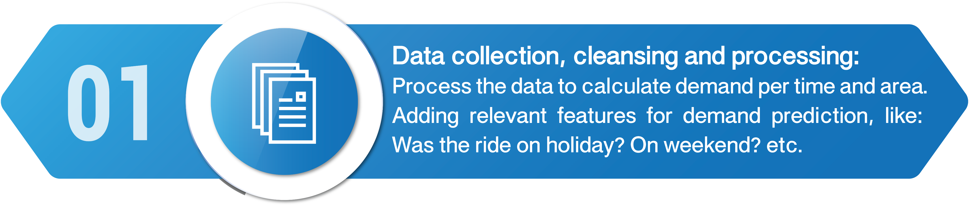


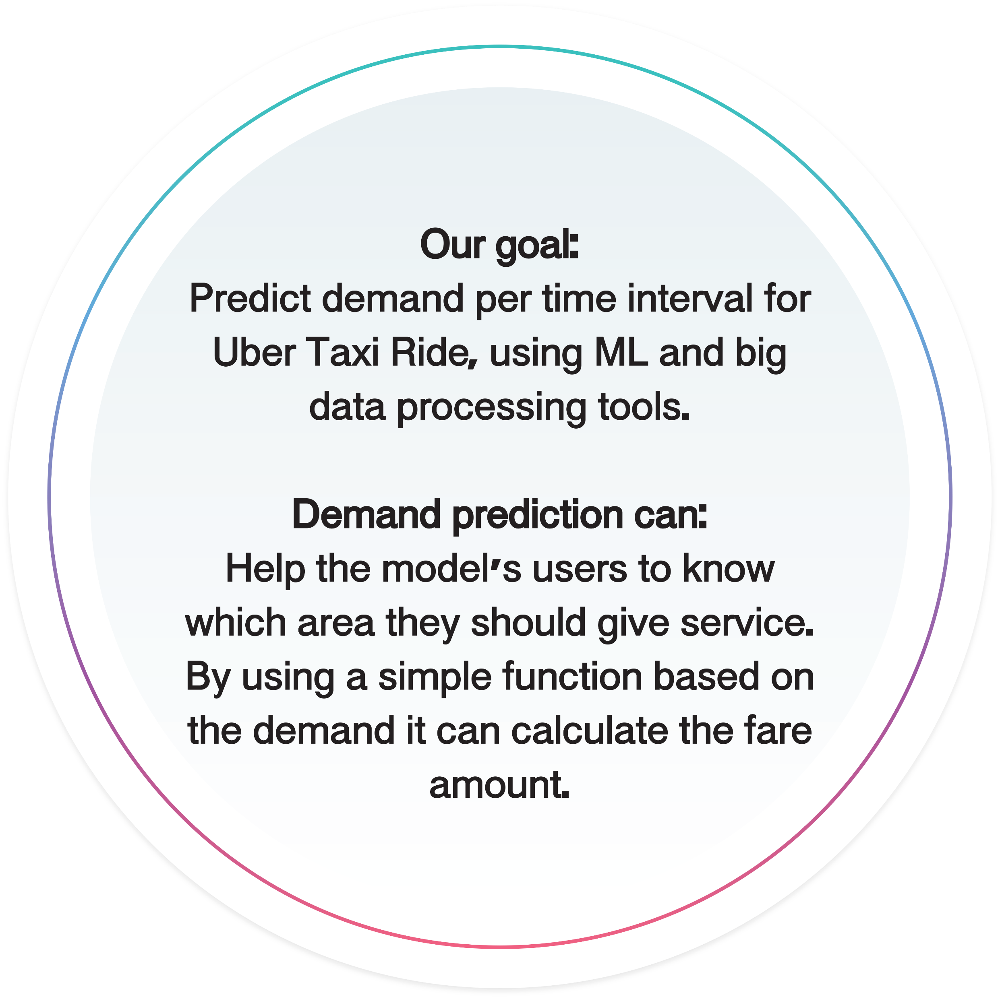


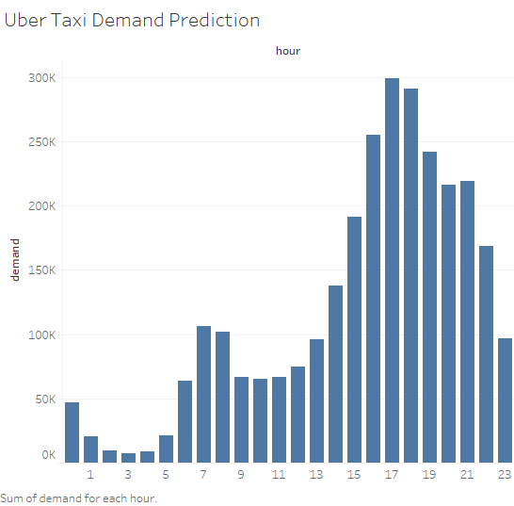
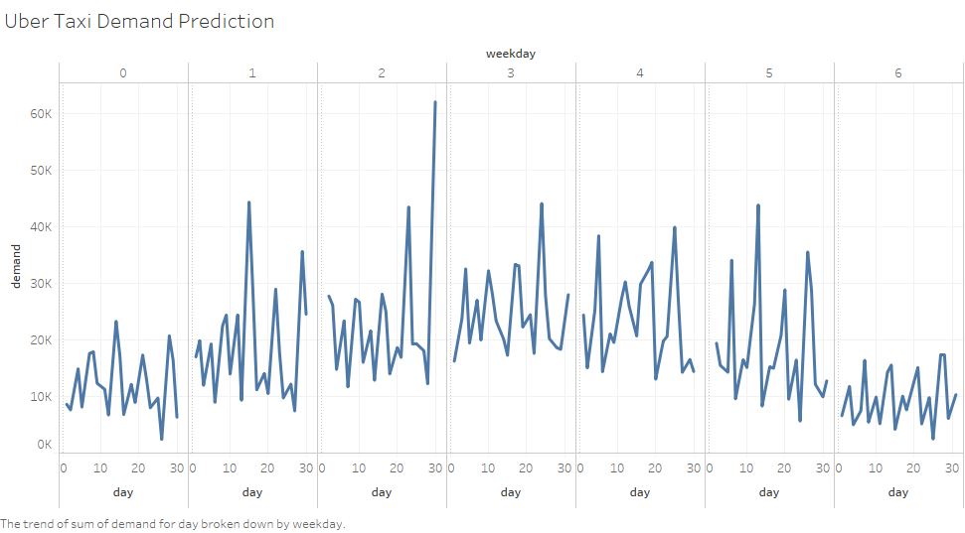
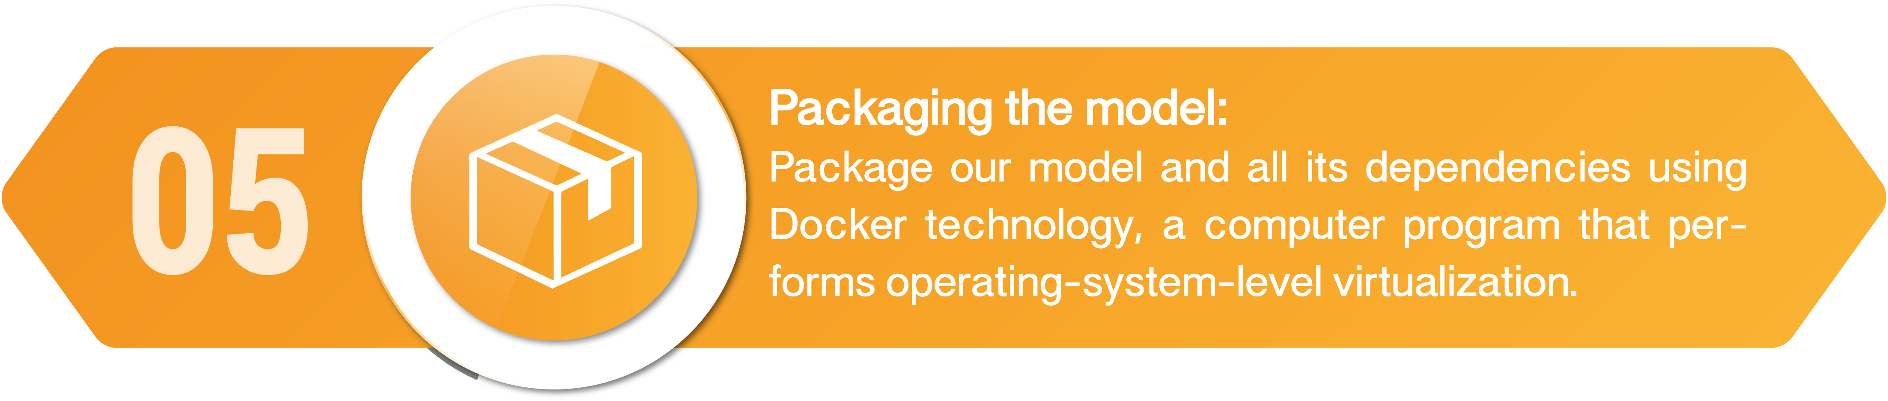








Streaming Uber Taxi Demand Prediction
Liz Aharonian & Ori Ben-Zaken
Supervisors: Barak Bar-Orion, Yohana Khoury, Yoav Einav, Tal Doron

